Slide 1

Object Classification in Urban Aerial Drone Footage
Jack, Aidan, Liam

Slide 2
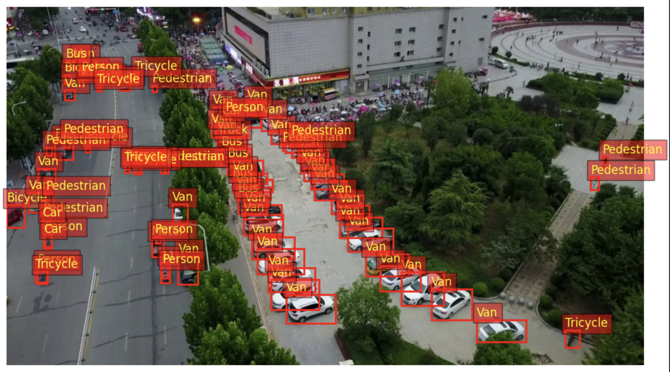
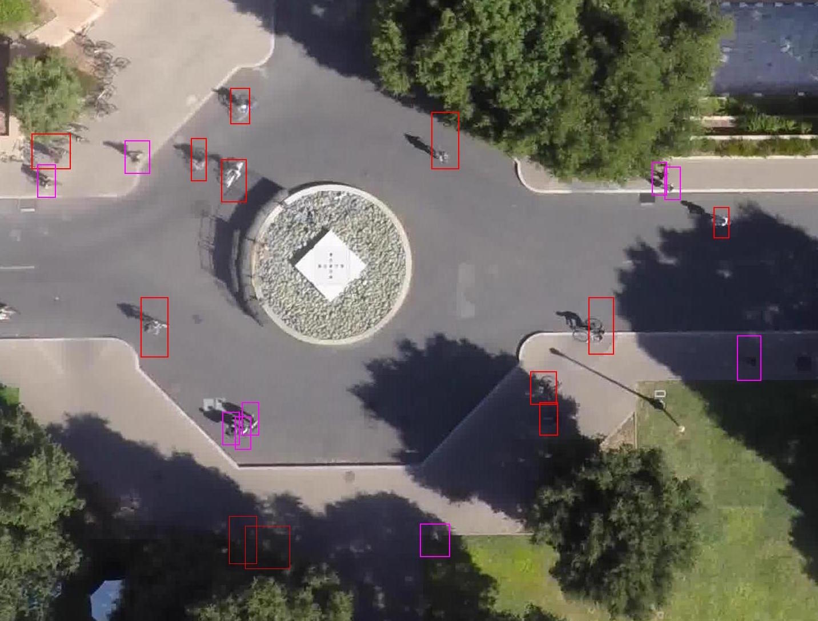
Project Recap
Objective:
Create a computer vision object classification model to identify objects in aerial drone videos
Prior Research:
Stanford Drone Dataset
Our dataset:
VisDrone Dataset
300 videos, ~260,000 frames of urban Chinese cities

Slide 3
Baseline Model
PyTorch Torchvision Faster R-CNN
Object detection model pre-trained on COCO
330,000+ images and wider variety of locations
Includes same VisDrone classes (Pedestrian, Car, etc…)
Simple CNN model
Small # of parameters (2-3 layers, no drop-off or optimizations, etc)

Slide 4
Our Model Architecture
Transfer Learning:
Load pretrained ResNet-50 or -101 model with FPN (better suited for drone images)
Freeze or allow fine-tuning
Remove original detection layers (head)
Region Proposal Network (RPN):
Use built-in RPN layers to generate regions
Anchor box tuning as needed (e.g. smaller sizes)
Region of Interest (ROI) Head:
Customize ROI detection box head layers with dropout regularization
Add final box predictor, specified for VisDrone data
Training Optimizations:
Data augmentation
Optimizers (SGD with momentum, L2 regularization)
Learning rate scheduling
Early stopping

Slide 5
Evaluation Criteria
Modeled off VisDrone’s official competition criteria:
Average Precision: “quality”
Precision = TP / (TP + FP)
Measures the accuracy of classifications and precision of bounding boxes
Intersection over Union (the closeness of two bounding boxes)
Average Recall: “quantity”
Recall = TP / (TP + FN)
Measures the model’s ability to find all the relevant objects in an image

Slide 6
Notes from Presentation
Check out interest over union (IOU) later for differing image sizes
Should be using YOLO or R-CNN model for object detection
Check literature of other drone deep learning projects to see what they use
If not using one of these in final project, should be good explanation why not
Try minimizing complexity at beginning by only attempting to detect one class
Potentially use one hot encoding for multiple classes training
Test with negative examples too (where boxes have nothing on purpose)

